Slide 1
Employee Data Analysis using Excel
STUDENT NAME: THANU SRI.V
REGISTER NO: 312209945 (asunm1363312209944)
DEPARTMENT: B.com BANK MANAGEMENT
COLLEGE: VALLIAMMAL COLLEGE FOR WOMEN

Slide 2
PROJECT TITLE
Employee Performance Analysis using Excel

Slide 3


AGENDA
Problem Statement
Project Overview
End Users
Our Solution and Proposition
Dataset Description
Modelling Approach
Results and Discussion
Conclusion
3/21/2024 Annual Review

Slide 4

PROBLEM STATEMENT
Utilise Excel to efficiently analyse employee data by leveraging function Such as pivot table and conditional formatting.
It enable the identification of key trends such as current employee rate, performance level
It helps to visualise the data through pivotchart

Slide 5
PROJECT OVERVIEW
.This project focuses on analysing employee data to identify trends and insights that can drive better decision
This project analyse the highlights' areas of improvement to workforce management and help to optimise resource allocation
The aim of this project is to support strategic planning

Slide 6

WHO ARE THE END USERS?
The end uses of The employee data analysis are useful to :
HR managers
Team leaders
Senior management

Slide 7

OUR SOLUTION AND ITS VALUE PROPOSITION
Conditional formatting- highlights missing cells
Filter – helps to remove the empty cell
Formulas- helps to identify the performance of employees
Pivot table- helps summarise
Pivot chart- shows the data

Slide 8
Dataset Description
Employee I’d
First name
Last name
Business unit
Employee type
Gender
Work location

Slide 9

THE "WOW" IN OUR SOLUTION
Conditional formatting
That helps in filling the colour in missing cells
Filter by colour
That filters the cell by sort out by colour
Pivot chart
That helps to visualise the data in simple way
3/21/2024 Annual Review
9

Slide 10
MODELLING
Data collection:
Identification
Gathering
Preparation
Data cleaning:
Standardisation
Correction
Validation
Summary :
Data analysis involves examning , transforming and modelling data to extract insights, identify pattern and support decision making
10

Slide 11
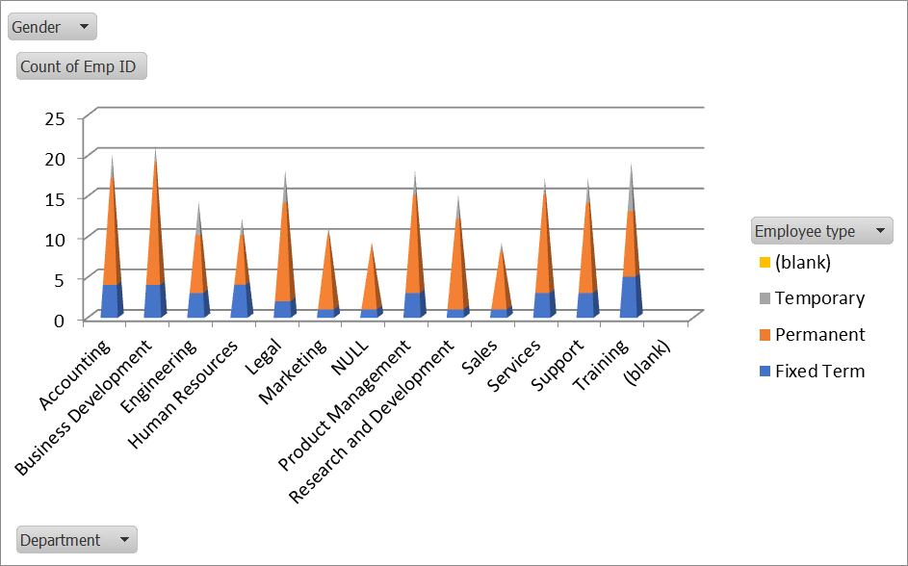
RESULTS
EMPLOYEE PERFORMANCE ANALYSIS
11

Slide 12
conclusion
In conclusion, the employee data analysis conducted using Excel provided valuable insights into workforce trends enabling more information for decision making
The use of Excel allowed efficient data organisation, visualisation and reporting, ultimately helps to enhance HR strategies and optimise overall organisational performance

